Slide 1
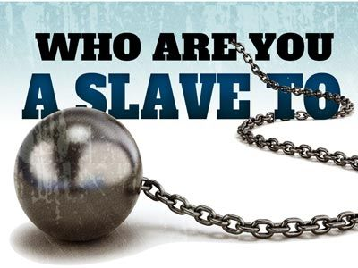

Slide 2
“So you also must consider yourselves dead to sin and alive to God in Christ Jesus. Therefore, do not let sin exercise dominion in your mortal bodies, to make you obey their passions. No longer present your members to sin as instruments of wickedness,…”
Romans 6v11-14

Slide 3
“…but present yourselves to God as those who have been brought from death to life, and present your members to God as instruments of righteousness. For sin will have no dominion over you, since you are not under law but under grace.”
Romans 6v13b-14

Slide 4
“What then? Should we sin because we are not under law but under grace? By no means!”
Romans 6v15

Slide 5
“Do you not know that if you present yourselves to anyone as obedient slaves, you are slaves of the one whom you obey, either of sin, which leads to death, or of obedience, which leads to righteousness?”
Romans 6v16

Slide 9
“In everything do to others as you would have them do to you; for this is the law and the prophets. “Enter through the narrow gate; for the gate is wide and the road is easy that leads to destruction, and there are many who take it. For the gate is narrow and the road is hard that leads to life, and there are few who find it.”
Matthew 7v13-14

Slide 10
“Teacher, which commandment in the law is the greatest?” He said to him, “’You shall love the Lord your God with all your heart, and with all your soul, and with all your mind.’ ³⁸This is the greatest and first commandment.
Matthew 22v34-40

Slide 11
And a second is like it: ‘You shall love your neighbor as yourself.’ On these two commandments hang all the law and the prophets.”
Matthew 22v34-40

Slide 12
For just as you once presented your members as slaves to impurity and to greater and greater iniquity, so now present your members as slaves to righteousness for sanctification.
Romans 6v19

Slide 13
But now that you have been freed from sin and enslaved to God, the advantage you get is sanctification. The end is eternal life. ²³For the wages of sin is death, but the free gift of God is eternal life in Christ Jesus our Lord.
Romans 6v22-23

